Slide 1
Smart Attendance System using Face Recognition
CSE3013 - Artificial Intelligence J Component Review
Submitted By:
Abhinav Jaiswal-20BCE2624
Vanshit Kandoi-20BCE2667
Sneha Jayshri-20BCE2673
Guided By:
Professor: Dr. ANNAPURNA JONNALAGADDA

Slide 2
Abstract
Humans can be identified by their distinct face features. A given face is compared to the faces kept in the database in order to identify the individual in the face recognition technique. The goal is to select a face in the database that is the most similar to the one being used.
Facial recognition technology is one of the fastest developing topics in biometrics. The growth in commercial interest and the development of practical technologies to enable the development of face recognition can be ascribed to the current interest in face recognition.
Biometrics, law enforcement and surveillance, human-computer interface, and multimedia management are all areas of economic interest. (For example, automatically labelling a certain person in a collection of digital images) Access control, smart cards, passport checks, criminal investigations.

Slide 3
Abstract
The face is the most important portion of the human body, and its distinctive traits make it even more important for human identification. Various techniques and technologies are utilised across the world to improve the accuracy and reliability of face recognition.
Healthcare, security, defence, forensics, and transportation are all areas where this ever-expanding technology is being used, and greater precision is required. However, in developing facial recognition technology, some obstacles are universal, such as position, occlusion, emotions, ageing, and so on.

Slide 4
Problem statement
Attendance is an important part of daily classroom evaluation. The teacher often checks it at the start and end of class, although it's possible that they might miss someone or check some students' answers more than once. Face recognition technology based on high definition monitor video and other information technology is used to solve the problem of recognizing faces for the purpose of taking attendance.

Slide 5
Gaps Identified
Enhancement required in face recognition library i.e., DLIB.
Lack of a proper dataset to work on The very first problem we were faced with was the absence of a dataset containing single line sentences and the keywords present in them, on which we could train our model on.
Dataset insertion then error came up: After inserting the new dataset we encountered some errors. In line -- 9 encoding = face_recognition.face_encodings(face)[0] We were facing issues in previously running the code. IndexError: list index out of range. Rectification : if face_recognition.face_encodings(face): encoding = face_recognition.face_encodings(face)[0] encoded[f.split(".")[0]] = encoding
Deciding the Biometrics for our Model: In the ideation process we weren't sure of this idea at first, we thought of doing some kind of setting up of multimodal detection based biometrics in our Healthcare based Project but after going through research papers and some blogs and journals we finally decided to fix this to face recognition.

Slide 6
Result and analysis
This system will include a way for the lecturer or teaching assistant to track the attendance of students throughout a lecture, section, or lab. It will save time and effort, especially if there are a lot of pupils in the lecture.
The aim of the automated attendance system is to minimize the shortcomings of the conventional (manual) approach. The application of image processing techniques in the classroom will be demonstrated via this attendance system.
This approach will enhance an institution's reputation in addition to simply assisting with the attendance system.

Slide 7
Continued…
Training of the AI model on our extensive data set was successful.
Initially data set was split into 70-30 ratio.
Around 1500 sample images were used for training.
AI model was then tested upon around 800 images.
In the end AI model was tested.

Slide 8
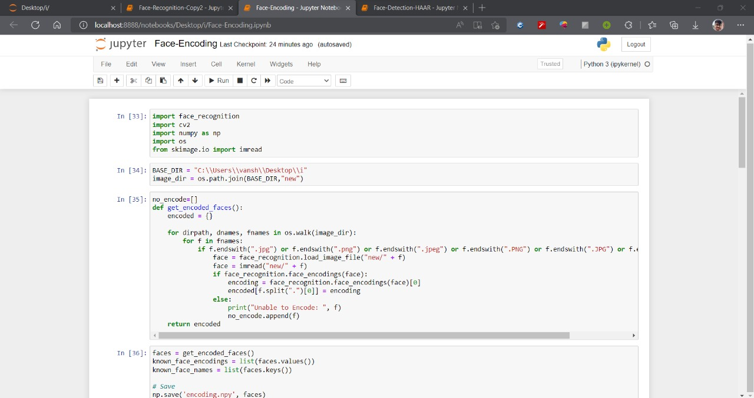
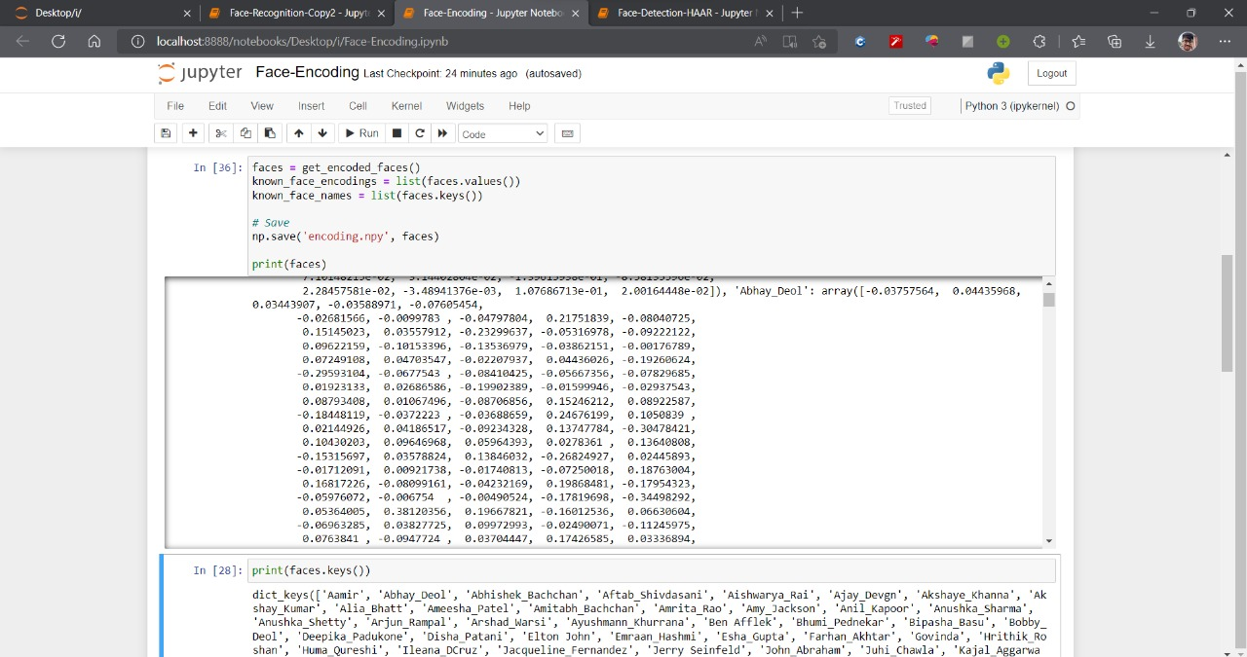
Result and analysis
Face Encoding

Slide 9
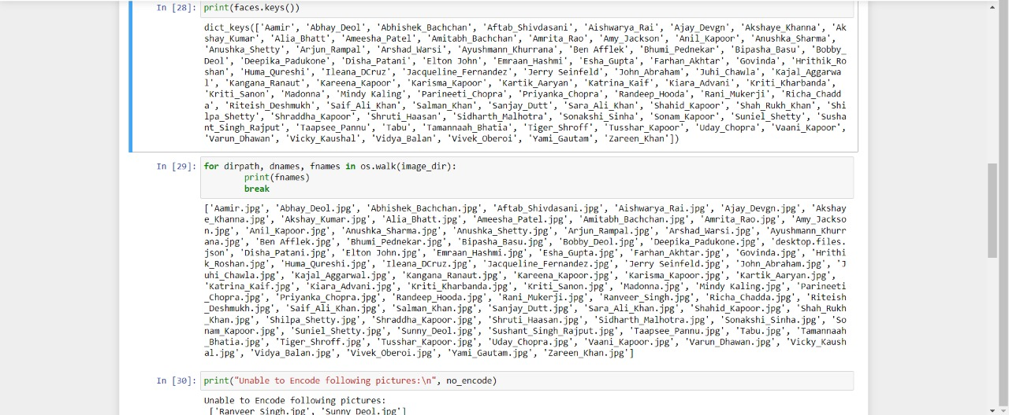
Result and analysis

Slide 10
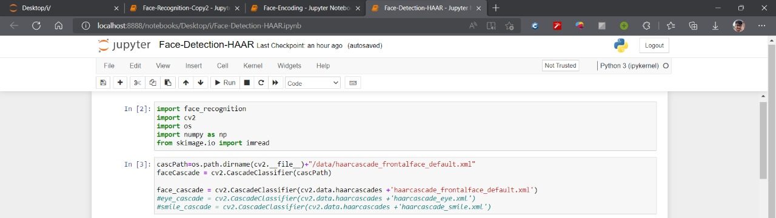
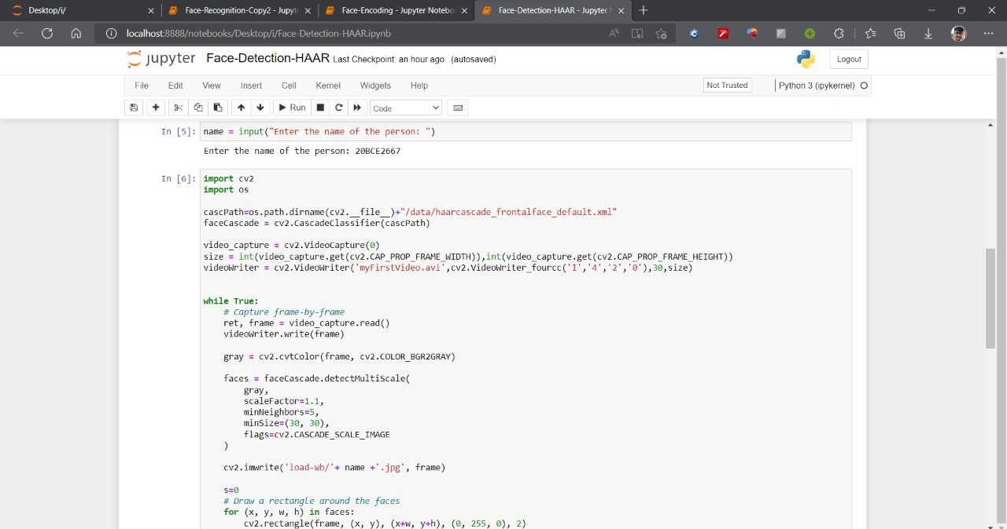
Result and analysis
Face Detection

Slide 11
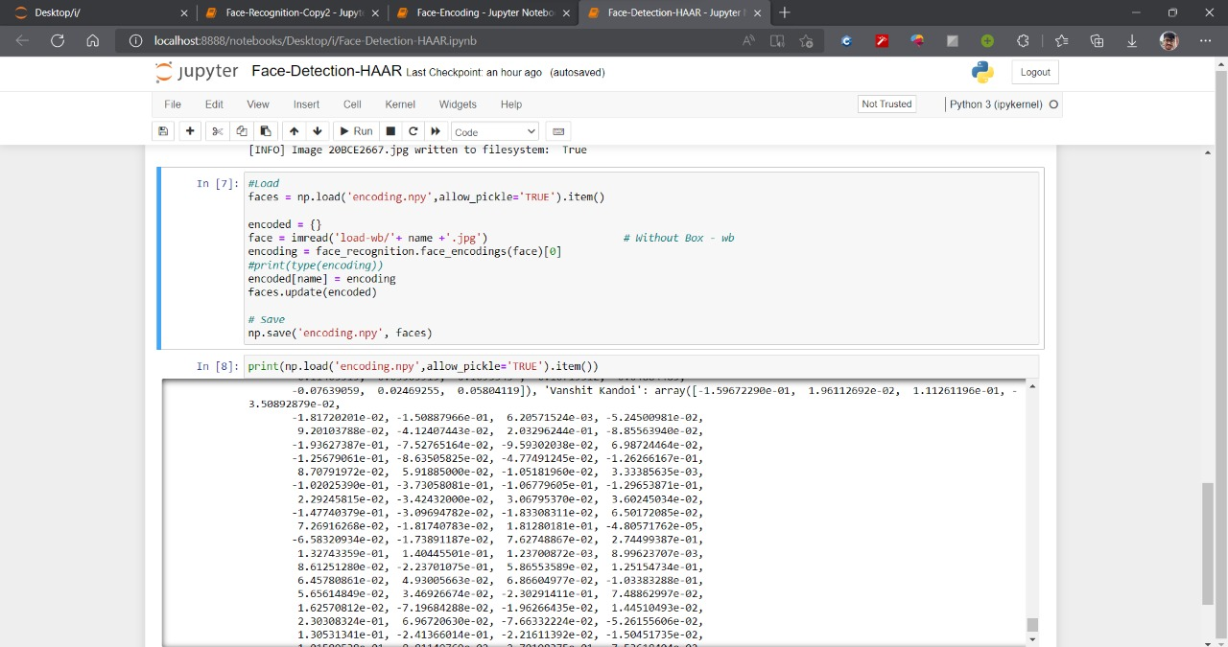
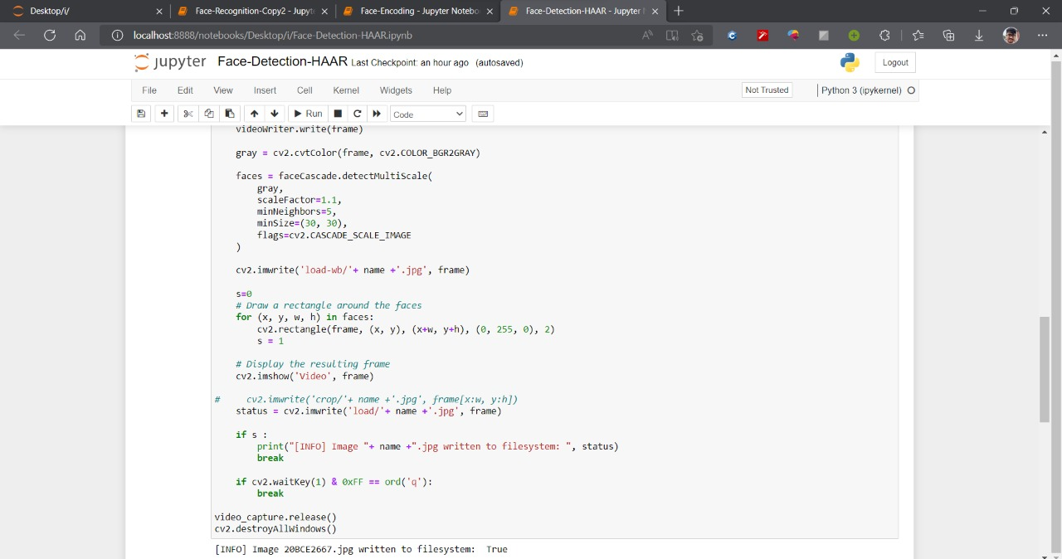
Result and analysis

Slide 12
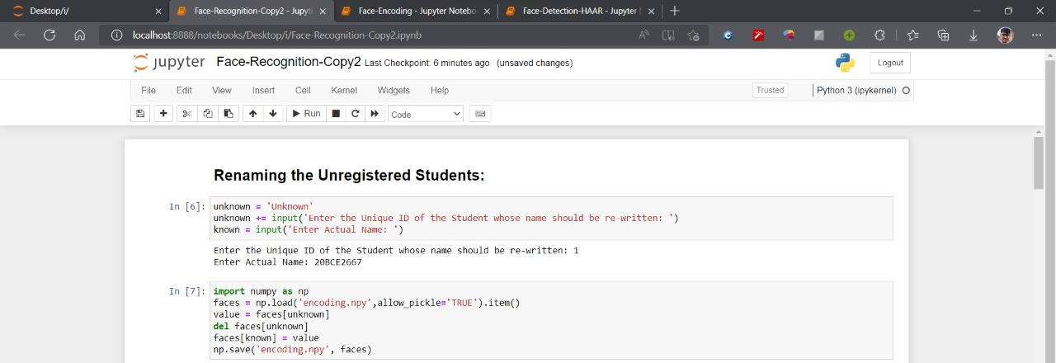
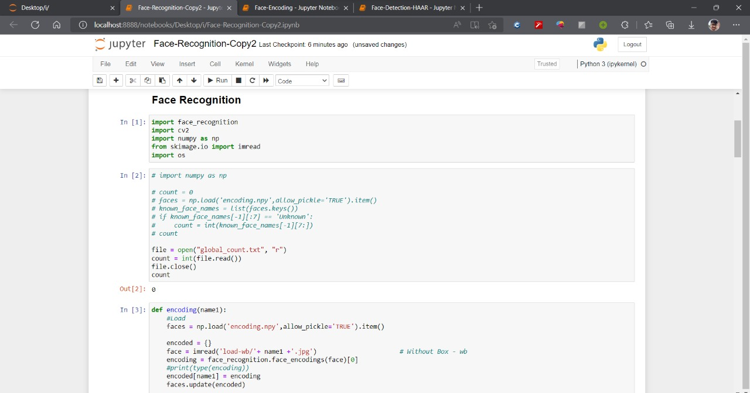
Result and analysis
Face Recognition

Slide 13
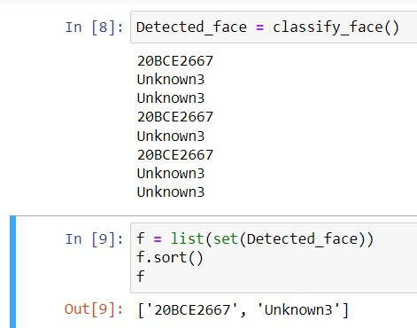
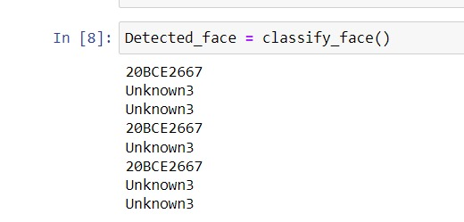
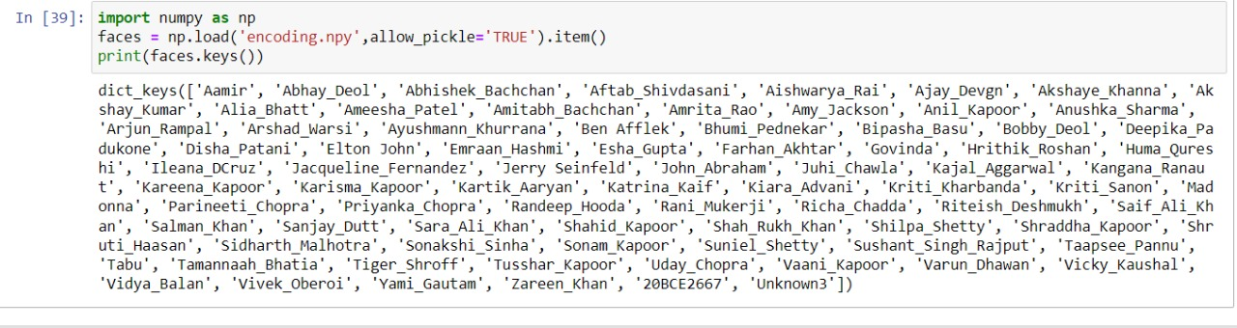
Result and analysis
Unknown user detected

Slide 14
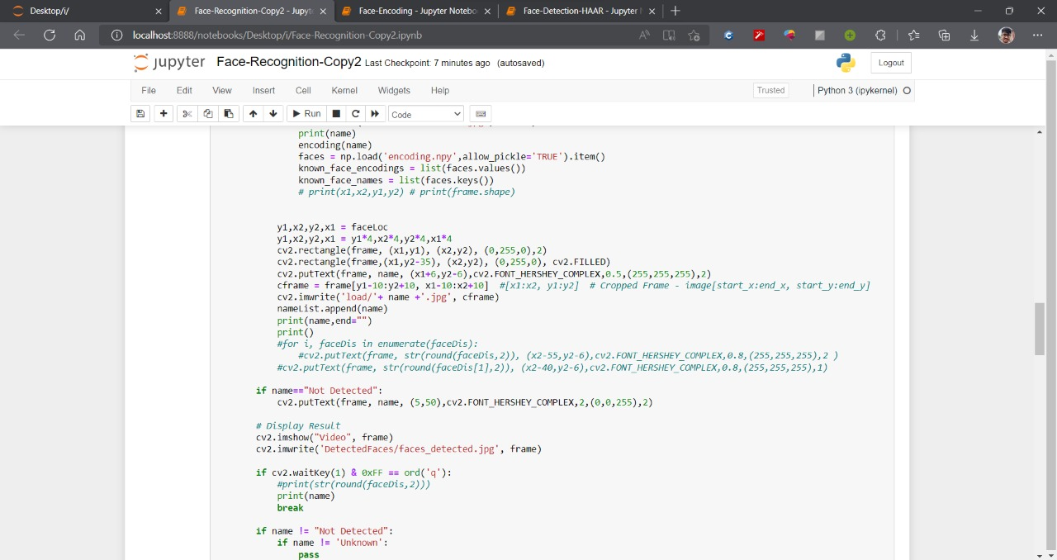
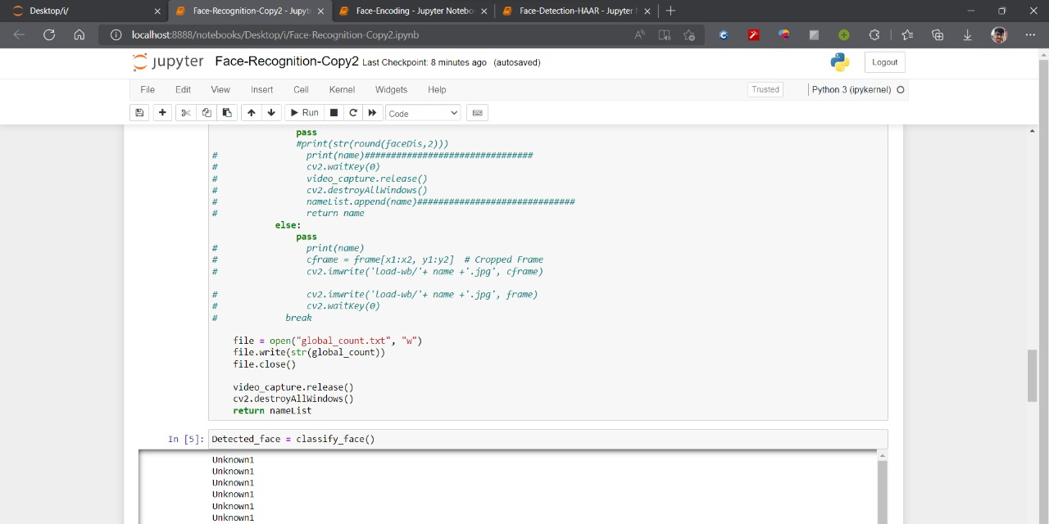
Result and analysis

Slide 15
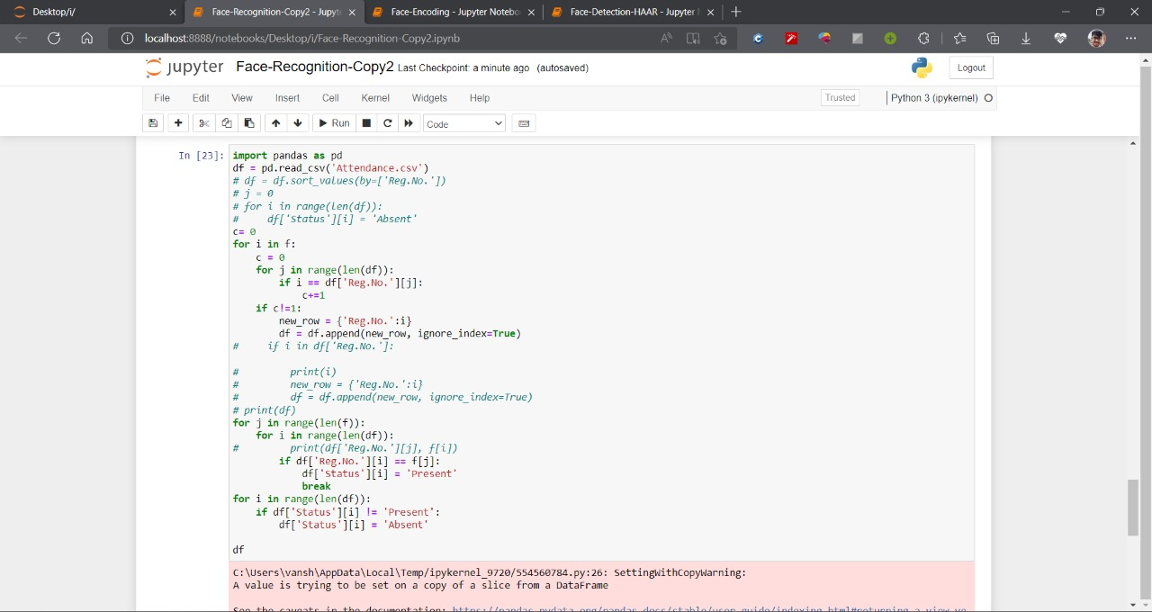
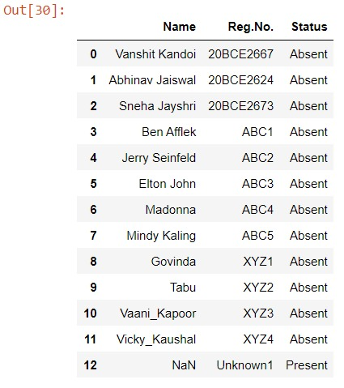
Result and analysis

Slide 16
Continued…
This system will include a way for the lecturer or teaching assistant to track the attendance of students throughout a lecture, section, or lab. It will save time and effort, especially if there are a lot of pupils in the lecture.
The aim of the automated attendance system is to minimize the shortcomings of the conventional (manual) approach. The application of image processing techniques in the classroom will be demonstrated via this attendance system.
This approach will enhance an institution's reputation in addition to simply assisting with the attendance system.

Slide 17
References
http://www.ijracse.com/olvolume7issue2/Roshini-2.pdf
https://pyimagesearch.com/2021/04/19/face-detection-with-dlib-hog-and-cnn/
https://pypi.org/project/dlib/
https://www.analyticsvidhya.com/blog/2022/04/face-detection-using-the-dlib-face-detector-model/
https://www.crunchbase.com/organization/keyless-technologies-ltd/technology
https://en.wikipedia.org/wiki/Facial_recognition_system
https://www.electronicid.eu/en/blog/post/face-recognition/en
https://towardsdatascience.com/face-recognition-for-beginners-a7a9bd5eb5c2
http://winteknologi.com/img/product/pdf/ede8225c99f6e1883d4ae14c66fb20191117.pdf
https://doi.org/10.1109/ICEEICT53905.2021.9667836
https://www.kaggle.com/havingfun/100-bollywood-celebrity-faces
https://www.sciencedirect.com/science/article/pii/S2666285X21000728
https://www.intechopen.com/chapters/51031

Slide 18
Work distribution among team members
Each member has worked how to make each section of the code more efficient.
Face Encoding: Vanshit Kandoi and Abhinav Jaiswal together worked with the face encoding model. After implementing the basic code and understanding the concept of encoding they brought changes to the code according to the need of their project. And then they saved a lot of space and time complexity to make the code efficient and reliable. Instead of storing the images, they stored the encoding which changed MBs to KBs.
Live Face Detection (using HAAR): Sneha Jayshri came up with this fabulous idea that it's better to take pictures by detecting the face by a different algorithm in order to make the later encoding more efficient. She brought this HAAR-Cascade Detector which suited our project the best as it had high accuracy levels. Then she along with other members implemented the coding of this Cascading Model. They both handled the modification in the code. They added the newly detected face directly into the encoding file saving the time complexity of running all faces encodings all over again.
Multiple Face recognition:Vanshit worked on implementing multiple face recognition.This was implemented successfully .

Slide 19
Work distribution among team members
Dataset:Abhinav and Sneha collected the dataset and helped in training the model.
Face Recognition:Here, all the members implemented the code and removed the errors. All of them had to work together as there were many errors which they were facing as they tried to manipulate the program according to their project requirements. All come up with great ideas and approach to overcome the issues.
Documentation: All the members of the team put in equal efforts in contributing to the documentation and ppt.

Slide 20
THANK YOU !

